Slide 1

Apache ActiveMQ
Dima Ionut Daniel

Slide 2
Contents
What is Apache ActiveMQ?
Features
Why and When?
Architecture
MOM and JMS
JMS Domains
Administered objects
Examples
ActiveMQ Connectors
ActiveMQ Core
ActiveMQ Message Storage
Security
ActiveMQ Advanced
Performance
Conclusions
Bibliography

Slide 3

What is Apache ActiveMQ?
ActiveMQ is an open source message broker written in Java.
ActiveMQ contains a full JMS(Java message Service) client.
ActiveMQ is used in enterprise service bus implementations such as Apache ServiceMix, Mule, Apache Camel.

Slide 4
Features
JMS compliance:
Implementation of JMS .1 spec.
Connectivity:
Wide range of connectivity options like: HTTP/S, SSL, STOMP, TCP, UDP, XMPP.
Pluggable persistence/security:
Multiple flavors of persistence and cutom security.
Client APIs:
Provides clients like Java, C/C++, .NET, Perl, PHP, Python, Ruby.
Integration with application servers:
Integration with Apache Tomcat, Jetty, Apache Geronimo, Jboss.
Broker Clustering:
Can work as a federated network of brokers.
Simplified administration:
Provides easy to use powerful administration features.

Slide 5
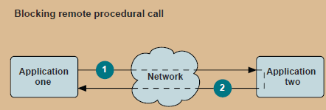
Why and When?
ActiveMQ was meant ot be used as the JMS spec intended, for remote communications between distributed applications.
ActiveMQ provides the benefits of loose coupling for application architecture.

Slide 6
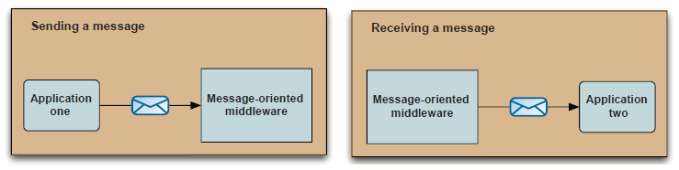
Why and When? (cont.)
ActiveMQ broker is written in Java and provides lots of clients implementations.
It can be used to integrated applications written in different languages on different platforms.

Slide 7
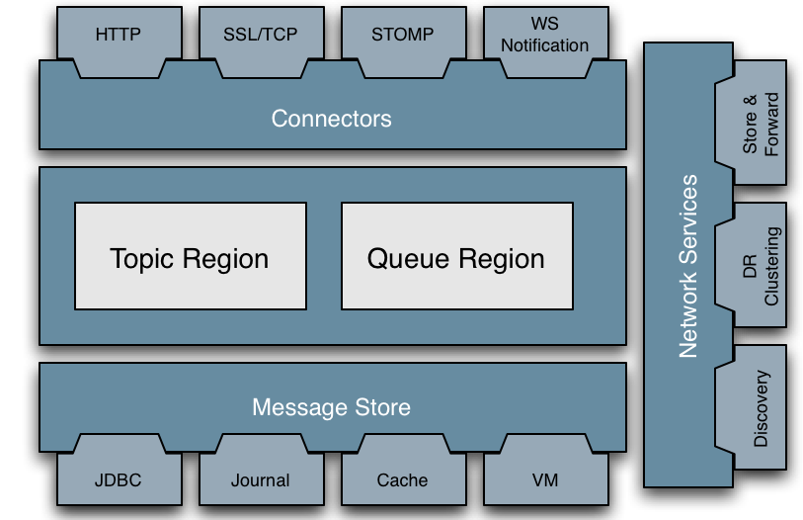
Architecture

Slide 8
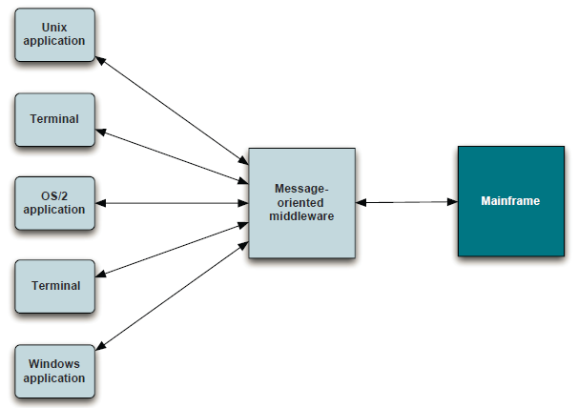
MOM and JMS
ActiveMQ is a MOM(Message-Oriented Middleware) product that provides asynchronous messaging for business systems.
MOM is best for communication in an asynchronous, loosely-coupled, reliable, scalable and secure manner.
MOM acts as a mediator between message senders and message receivers.
The mediation provides a whole new level of loose coupling.

Slide 9
MOM and JMS (cont.)
At a high level, messages are a unit of business information that is send between application to another via the MOM.
Applications send and receive messages via the MOM using the destinations.
The sender and the receiver doesn’t know anything about each other. This is called asynchronous messaging.

Slide 10
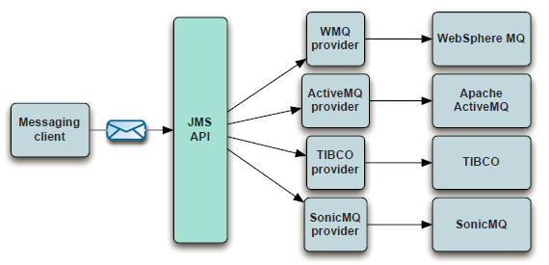
MOM and JMS (cont.)
JMS(Java Message Service) is an API that provides a standarlized API to send and receive messages using Java.
JMS isn’t itself a MOM, it’s an API.
The API was created by Sun in conjunction with a group of companies in 1998.
The latest release was in 2002.

Slide 11
MOM and JMS (cont.)
JMX defines concepts like:
JMS client: application written in Java to send/receive messages.
Non-JMS client: application that uses JMX provider’s native client API to send/receive messages.
JMS producer: client application that creates/sends JMS messages
JMS consumer: client application that receives/processes JMS messages
JMS provider: implementation of JMS interfaces
JMS message: payload that is exchanged between JMS clients
JMS domains: 2 styles of messaging: point-to-point and publish/subscribe.
Administered objects: preconfigured JMS objects that contain provider-specific configuration data for use by clients.
Connection factory: clients use connection factory to create connections to JMS provider
Destination: object to which messages are addresses and sent.

Slide 12
MOM and JMS (cont.)
JMS clients uses the MessageProducer and MessageConsumer interfaces.
Headers are set automatically by the client’s send method:
JMSDestination:
The destination to which the message is being sent.
JMSDeliveryMode:
Supports 2 types of delivery modes: persistent and nonpersistent.
JMSExpiration:
Time that a message will expire.
JMSMessageID:
Unique identifies a message.
JMSPriority:
Assigns a level of importance to a message.

Slide 13
MOM and JMS (cont.)
JMSTimestamp:
Denotes the time the message was sent by the producer to the JMS provider.
JMSCorrelationID:
Used to associate the current message with a previous message.
The header is used to associate a response messag with a request message.
JMSReplyTo:
Specify a destination where a reply should be sent.
JMSType:
Identifies the message type
JMSRedelivered:
Set by the JMS provider to indicate that a message was delivered but not acknowledged.

Slide 14
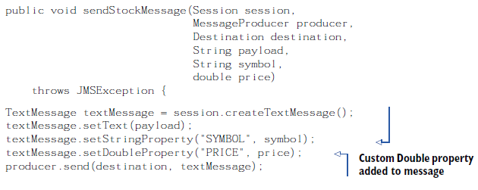
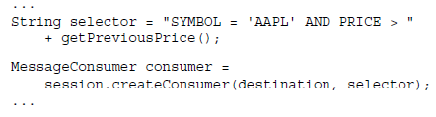
MOM and JMS (cont.)
Message selectors allows a JMS client to specify which messages it wants to receive from a destination based on values in message headers.
Selectors are conditional expressions defined using a subset of SQL92.
Selectors operator: AND, OR, LIKE, BETWEEN, =, <>, <, >, <=, =>, +, -, *, /, IS NULL, IS NOT NULL.

Slide 15
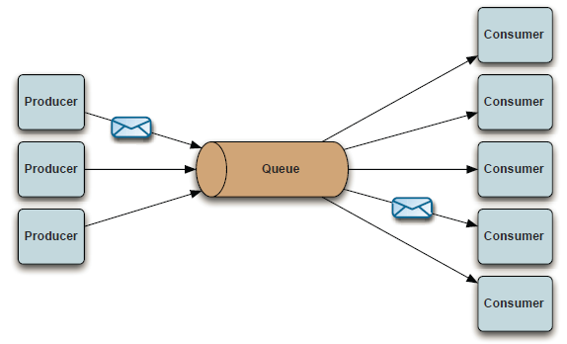
JMS Domains
There are 2 styles of messaging:
Point-to-point
Publish/subscribe.
Point-To-Point:
Uses destinations known as queue.
Messages are sent/receive synchronously/a synchronously.
Each message received on the queue is delivered ony and only once to a single consumer.

Slide 16
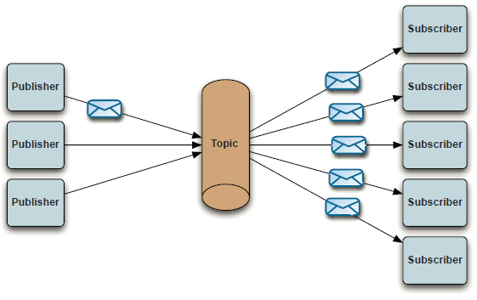
JMS Domains (cont.)
Publish/Subscribe
Uses destinations known as topics.
Publishers send messages to the topic and subscribers register to receive messages from the topic.

Slide 17
JMS Domains (cont.)
When clients connects to a topic they can use durable/nondurable subscription.
Durable subscription:
A durable subscription is infinite
If a durable subscriber disconnects, the JMS provider will hold all messages until the subscribers connects again.
Nondurable subscription:
A nondurable subscription is finite.
If a subscriber disconnects the JMS provider won’t hold any messages during the disconnection period.
Message persistence is independet of the message domain.
The quality of service is specified on the message producer’s setDeliveryMode method using the JMSDeliveryMode.

Slide 18
Administered objects
Administered objects contain provider-specific JMS configuration information.
These objects are used by the JMS clients.
The JMS spec defines 2 types of administered objects: ConnectionFactory and Destination.
ConnectionFactory:
Creates connections to a JMS provider.
JMS conections are used by JMS clients to create javax.jms.Session objects that represents JMS provider.
Destination:
Encapsulates provider-specific address to whcih messages are sent/received
Temporary destinations are unique to the connection that was used to create them.
Temporary destinations are commonly used for request/reply messaging.

Slide 19
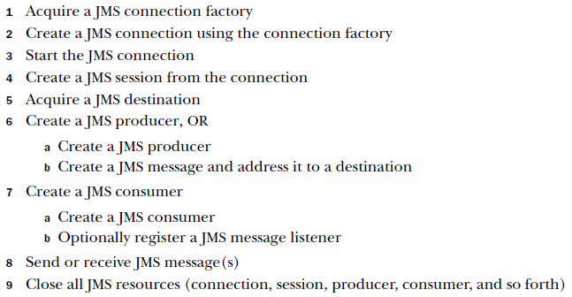
Examples

Slide 20
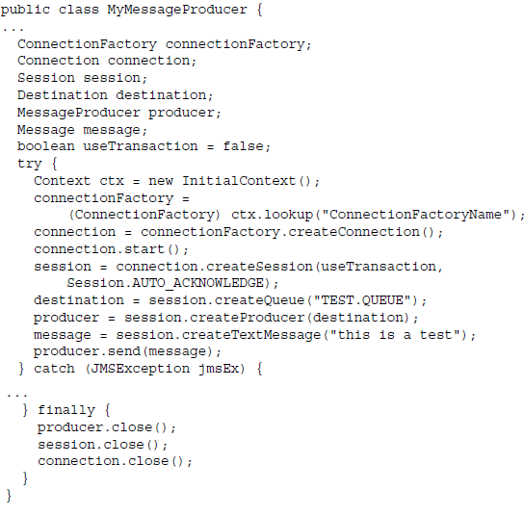
Examples (cont.)

Slide 21
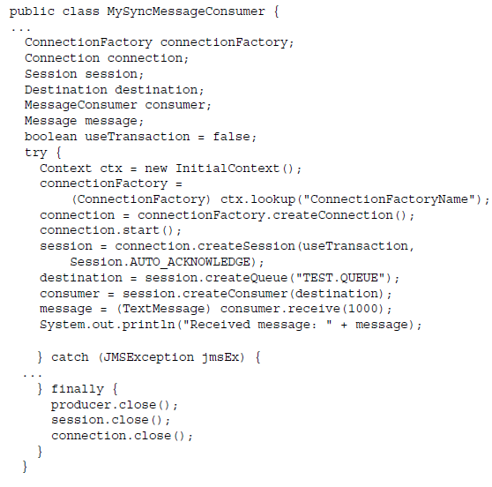
Examples (cont.)

Slide 22
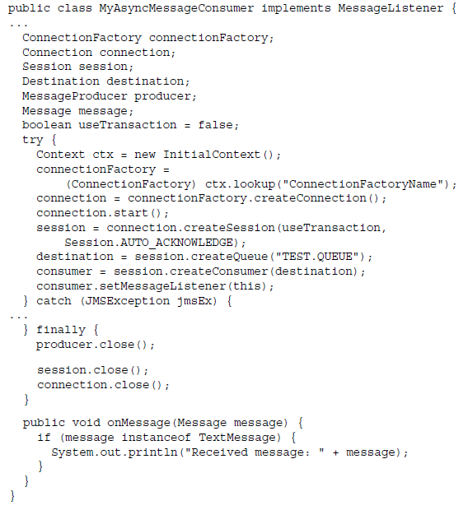
Examples (cont.)
The JMS API provides the ability to asynchronously receive messages.

Slide 23
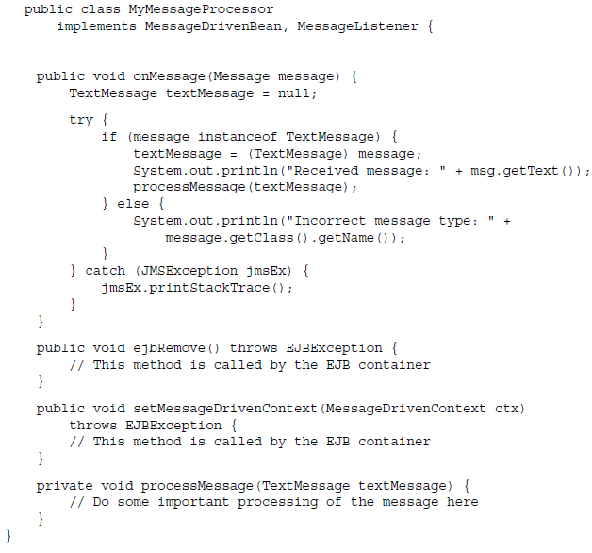
Examples (cont.)
Message-driven beans(MDB) were born out of the EJB 2.0 spec.

Slide 24
ActiveMQ Connectors
ActiveMQ supported connectors:
TCP: default network protocol.
NIO: better scalable for connections from producer and consumer to the broker.
UDP: used when we have a firewall between clients and the broker.
SSL: secure communication with firewall between clients and the broker.
HTTP(S): create HTTP(S) when we have a firewall between clients and the broker.
VM: used when clients and the broker are in the same JVM(Java Virtual Machine).

Slide 25
ActiveMQ Connectors (cont.)
TCP is used as network protocol used between hosts in packet-switched computer communication networks.
Messages must be serialized in/out and sent over the wire using the wire protocol.
The default wire protocol used in ActiveMQ is called OpenWire.
Its main purpose is to be efficient and allow fast exchange of messages over the network.
TCP transport connector benefits:
Efficiency:
uses OpenWire to convert messages to a stream of bytes.
Availability:
TCP is most widespread network protocols
Reliability:
ensures that messages won’t be lost on the network

Slide 26
ActiveMQ Connectors(cont.)
NIO was introduced in Java SE 1.4 and provides alternative approach to network programming.
NIO transport connector is implemented using NIO API.
NIO URI syntax example: nio://hostname:port?key=value .
UDP(User Datagram Protocol) can be used for sending and receiving data packets.
UDP syntax URI example: udp://hostname:port?key=value.

Slide 27
ActiveMQ Connectors (cont.)
SSL transport connector adds an SSL layer over TCP channel providing encrypted communication between brokers and clients.
Keys and certificates are involved in configuring the connector.
URI syntax sample: ssl://hostname:port?key=value
Keystores holds private certificates with corresponding private keys.
Trusted certificates of other entities(applications) are stored in trustores.

Slide 28
ActiveMQ Connectors (cont.)
The default keystores and trustores location for ActiveMQ is located in ${ACTIVEMQ_HOME}/conf directory.
The 2 files: broker.ks and broker.ts are used for the SSL transport connector.
The java clients needs to se the following system properties:
javax.net.ssl.keyStore: location of the keystore
javax.net.ssl.keyStorePassword: password of the keystore
javax.net.ssl.trustStore: location of the trustore

Slide 29
ActiveMQ Connectors (cont.)
Java utility keytool can be used for managing keystores and certificates.
prompt>keytool -genkey -alias broker -keyalg RSA -keystore mybroker.ks
prompt>keytool -export -alias broker -keystore myroker.sk -file mybroker_cert
prompt>keytool -import -alias broker -keystore clien.ts -le mybroker_cert

Slide 30
ActiveMQ Connectors (cont.)
HTTP(S) transport connector uses XML formatted messages over the HTTP(S) protocol.
URI syntax example: http(s)://hostname:port?key=value
The VM transport connector is used to launch an embedded broker and connnect to it.
Because the network is not used the performance improves significantly.
URI sytanx example: vm://hostname:port?key=value

Slide 31
ActiveMQ Connectors (cont.)
ActiveMQ supports failover protocol.
URI syntax: failover:(uri1,...,uriN)?key=value
ActiveMQ supports multicast connector.
URI syntax: multicast://ipAddress:port?key=vaue

Slide 32
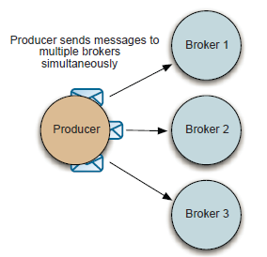
ActiveMQ Connectors (cont.)
ActiveMQ provides peer transport connector.
URI syntax: peer://peergroup/brokerName?key=value
Fanout is an utility connector used by clients that connects simultaneously to multiple brokers and replicate opetrations.

Slide 33
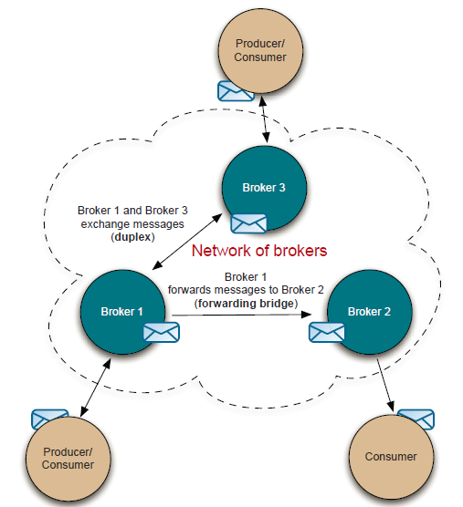
ActiveMQ Connectors (cont.)
Network connectors are channels that are configured between brokers.
A network connector is a unidirectional channel by default called also forwarding bridge.
ActiveMQ also supports bidirectional connector called duplex.

Slide 34

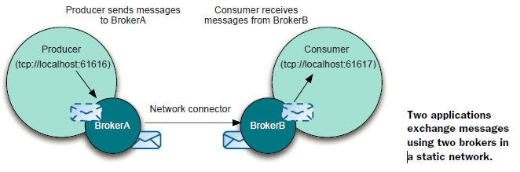
ActiveMQ Connectors (cont.)
A static network connector is used to create a static configuration of multiple brokers in a network.

Slide 35
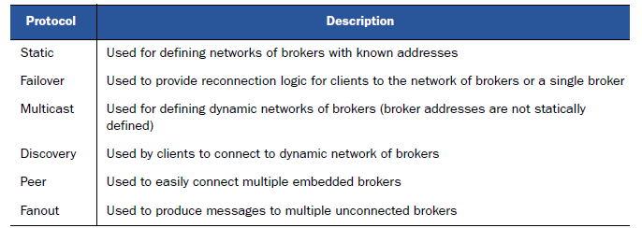
ActiveMQ Connectors (cont.)
Summary protocols used for network brokers

Slide 36

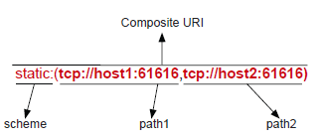
ActiveMQ Core
ActiveMQ provides connectors, a mechanism that provides client-to-broker communications.
The URI looks like: <scheme>://<authority><path><?query>. (example: tcp://localhost:61616)
ActiveMQ connectors are using this URI pattern to implement basic network communication protocols.
ActiveMQ provides an impressive list of protocols clients.

Slide 37
ActiveMQ Message Storage
The JMS specification supports 2 types of message delivery:
- persistent
- non-persistent
A message delivered with the persistent delivery property must be logged to stable storage.
ActiveMQ supports both message delivery types and also support message recovery(using in memory cache).
ActiveMQ supports pluggable strategy for message storage and provides storage options for in-memory, file-based, relational DB.

Slide 38
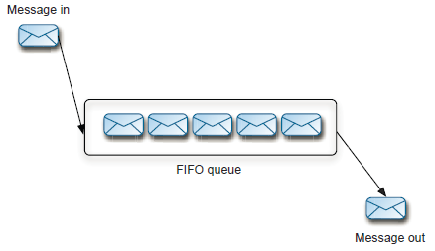
ActiveMQ Message Storage (cont.)
Messages are sent to queues and topics and are stored differently.
Storage for queues is using FIFO(First in, first out).

Slide 39
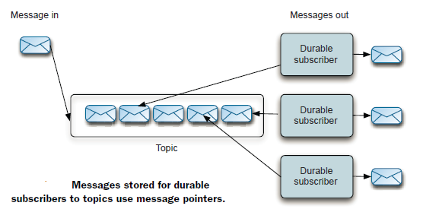
ActiveMQ Message Storage (cont.)
For durable subsribers to a topic, each consumer get a copy of the message.
Every message won't be deleted until all subscribers will consume it.

Slide 40
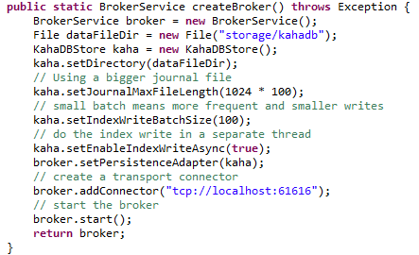
ActiveMQ Message Storage (cont.)
ActiveMQ KahaDB engine is a file-based message store that combines transactional journal for reliable message storage and recovery with good performance and scalability.
The goal of KahaDB store is to be easy to use and fast as possible.
In the above example we created the Kaha storage and assigned to the BrokerService.
Before starting the Broker we added a TCP connector.

Slide 41
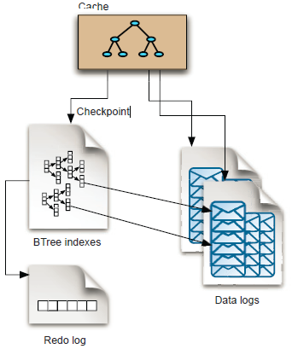
ActiveMQ Message Storage (cont.)
The KahaDB message store is the fastest of all provided message store implementations.
Data logs:
acts as a message journal
when maximum length is reached they are deleted or archived.
Cache:
holds message temporarily if there are active consumers
if messages are acknowledge in time they are not written to disk
BTree indexes:
holds references to the messages in the data logs that are indexed by their message ID.

Slide 42
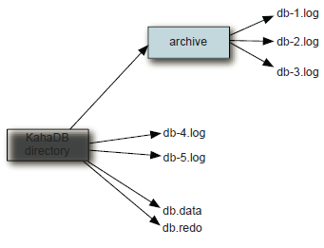
ActiveMQ Message Storage (cont.)
When ActiveMQ broker is configured to use KahaDB store a directory will automatically be created in which the persistent messages are stored.
Inside KahaDB directory following directory/structure can be found:
db log files: messages are stored in data log using the format: db-<Number>.log
db.data: contains persitent BTree indexes
db.redo: used for recovering the BTree indexes
archive: exists only if enabled.

Slide 43
ActiveMQ Message Storage (cont.)
ActiveMQ supports JDBC message store.
JDBC message store uses a schema consisting of a 3 tables: 2 tables holds messages and a third is used as a lock table.
ACTIVEMQ_MSGS: stores messages for both queues and topics.
ACTIVEMQ_ACKS: holds durable subscriber information.
ACTIVEMQ_LOCK: ensures that only one ActiveMQ broker instance can access the database at one time.

Slide 44
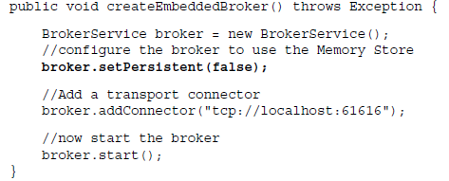
ActiveMQ Message Storage (cont.)
The memory message store holds all persistent messages in memory.
The memory store is used when broker property persistent is set to false(default is true).

Slide 45
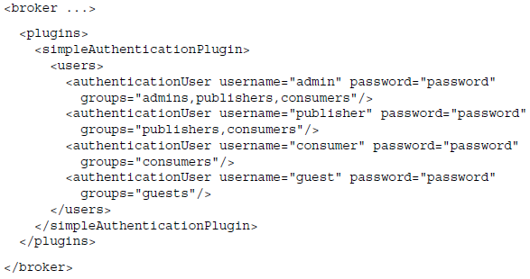
Security
Authentication verifies the integrity of an entity or user that's requesting access to a secured resource.
ActiveMQ provides simple authentications and JAAS(Java Authentication and Authorization Service) and an API for writing custom authentication plug-ins.
Authorization is used to determine the access rights of a user to a secured resource.
The easy way to secure the broker is through the use of authentication credentials placed directly in the broker configuration XML.

Slide 46
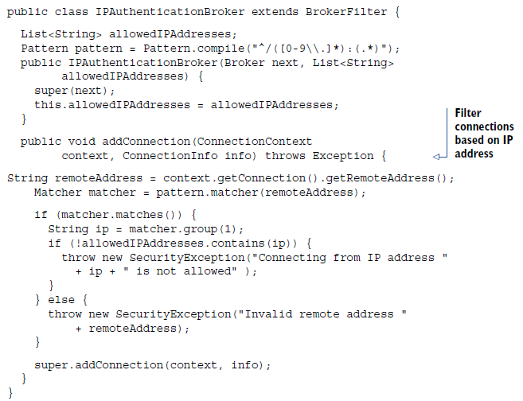
Security (cont.)
ActiveMQ provides 2 levelers of authorization:
operation-level authorization: read,write,admin
message-level authorization: allow,deny
We can implement IP filtering mechanism using ActiveMQ custom security plugins(extending BrokerFilter class).

Slide 47
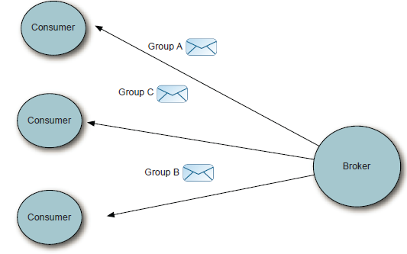
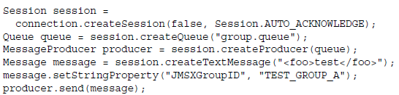
ActiveMQ Advanced
Message groups:
Instead of all messages going to a single message consumer, messages can be grouped together for a single consumer, and a message producer can designate a group for a message by setting the message header JMSXGroupID.

Slide 48
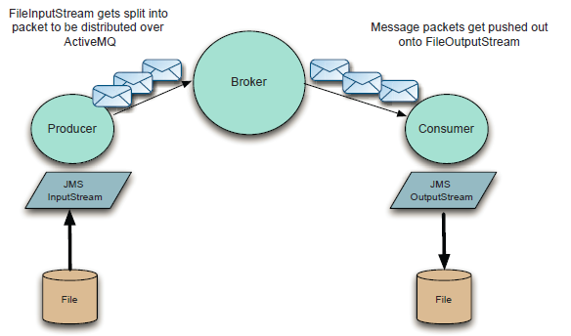
ActiveMQ Advanced (cont.)
ActiveMQ Streams are an advanced feature that allows the usage of IOStream.

Slide 49
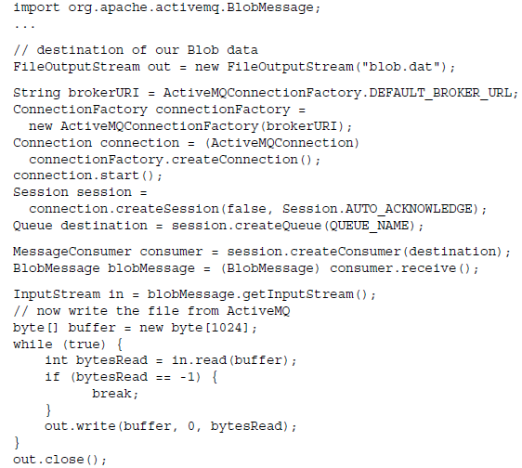
ActiveMQ Advanced (cont.)
ActiveMQ has the concept of blob messages so that large messages can be delivered.

Slide 50
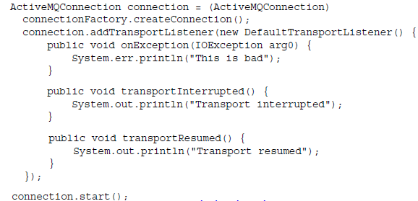
ActiveMQ Advanced (cont.)
We can define transport listener to ActiveMQ connections to determine network failures.

Slide 51
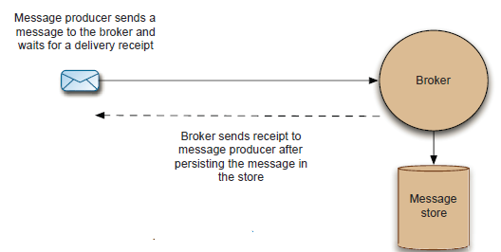
Performance
By default message delivery mode is persistent.
The message delivery non-persistent mode is more faster(for cases where we don’t care about the message delivery)

Slide 52
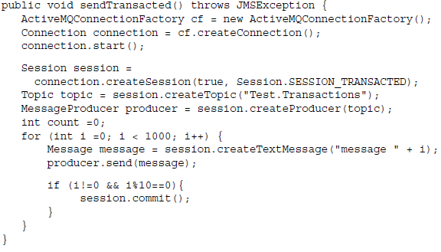
Performance (cont.)
We can send a batch of messages using transaction.

Slide 53
Conclusions
ActiveMQ it’s a powefull message broker.
ActiveMQ allows is configurable using XML or programatically.

Slide 54

Bibliography
http://en.wikipedia.org/wiki/Apache_ActiveMQ
Manning – ActiveMQ in Action

